Slide 1
Reinforcement Learning
WKSP 420 Module 2, Lesson 1
Notes:
Welcome to the lesson on Reinforcement Learning.

Slide 2

Supervised Learning
Notes:
We’ve learned and used supervised learning quite a bit. Think about how humans do supervised learning. A parent will give a child a ball and say the word “ball”, and repeat that with different types of balls. Over time, the child associates the word “ball” with the correct physical object.

Slide 3

Reinforcement Learning
Notes:
Now think about another way in which we learn. Parents and teachers can’t teach a child how and when to do everything. Instead, they define a set of rules, kids learn that if they do something that follows those rules, they get a reward. Maybe praise, or approval, or something more tangible like a dessert or video game time.
If they do something against those rules, then they get a punishment like being grounded, or way way worse: no Wifi use.
Kids will not immediately get the rules or understand the reward or punishment structure. As they do different things, they learn which set of activities fall within the boundaries of the rules.
Also, kids learn from their mistakes. That’s a huge advantage for human beings. If you first try to shoot a basketball, you will likely not make it. But you know that the basic idea is to throw the ball into the netted hoop. So you try different stances, different distances, different force and eventually you settle on some combination that nets you a basket the majority of the time.

Slide 4
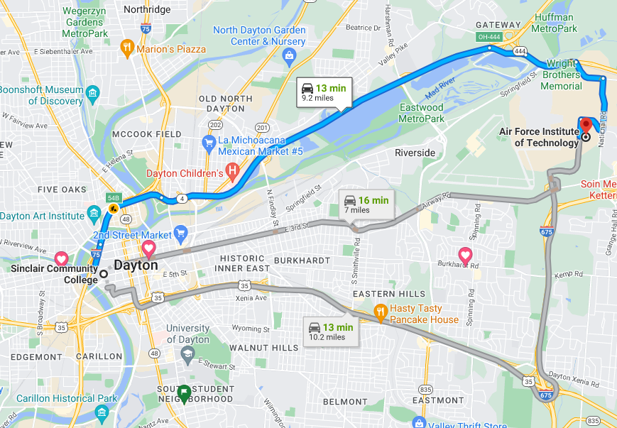
Why Reinforcement Learning
Supervised Learning – can’t learn every option
Conditions:
Only use paved roads
Duration < 1 hour
Winning Criteria:
Shortest distance, or
Shortest duration
Notes:
Supervised learning is an excellent tool when there are a finite set of correct answers and for each answer, there are many observations in a labelled data set. For example, supervised learning works well in image processing to identify handwritten numbers because there are only 10 possible choices for a single digit number, and many examples of each number. This lets the algorithm generalize for each class.
However, there are also classes of problems where instead of a finite set of solutions, there are a finite set of rules but a very large set of possible solutions. In those cases, it’s not possible to learn every possible solution through a supervised algorithm.
Here are some examples. If I’m planning a route from the base to the local community college, there are many possible ways to get there. The finite set of rules is that I can only travel on paved roads. You can add rules such as only looking for paths that I can travel in less than an hour. Here you can define a condition for the winning choice – the path with the shortest route by distance or time.
In this case, there are a lot of different ways to get from start to finish, and it’s not feasible to train a supervised algorithm with each path as a class.

Slide 5
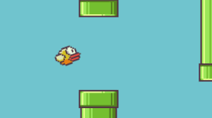
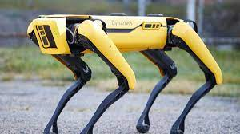
Conditions:
Only one input – tap to go up
Always moving forward
Winning Criteria:
Reach ending without dropping off screen
Conditions:
Must stay upright
Always moving forward
Winning Criteria:
Reach destination without falling
Don’t bump into things
Notes:
Here are some other examples.
In a video game, you learn what the goal is such as reaching the end of a level. And you learn how to get points and what can cause your character to fail.
There are now robots that can learn too. You might develop a set of rules such as always wanting to stay upright, and always moving forward. You might define goals as reaching a destination without bumping into anything. Then the robot needs to figure out how to move it’s legs to achieve those goals.

Slide 6
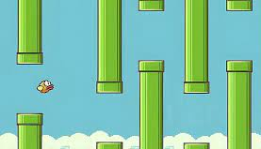
Tap, Tap, Tap, Tap, Tap, Tap, Tap, Tap, Tap, Tap
Fail
Tap, Tap, Tap, Tap, Tap, Tap, Tap, Tap, Tap, Tap
Success
Notes:
The algorithm doesn’t know ahead of time what set of inputs is needed to get to the end of the stage. Here, it will try different combinations and learn sequentially by paying attention to what worked before and what lead to the last failure. The algorithm will then make minute changes and play again to see if the new steps make it more successful.

Slide 7
Agent
Bird
State
Current location
Action
Flapping
Reward
Points
Winning Game
Environment
Game Environment
Notes:
Let’s define some terminology.
In reinforcement learning, there is an agent that is doing the action. In this case, the agent is the bird, and the action is flapping.
The environment is where the action in taking place. Here, the video game is the environment. In the case of the robot dog we just saw, the environment is the real world.
The State is the current situation of the Agent. Here, the state of the bird is where in the level it is located at the given time.
For each action in the environment, the agent either gets a reward for doing something right, or a punishment for getting something wrong.

Slide 8
Learning = Map Agent’s State to Next Action (Policy)
Agent
Bird
State
Current location
Action
Flapping
Tap button
Reward
Points
Winning Game
Environment
Game Environment
Notes:
The learning happens by the agent taking it’s current state as input and then determining what next step is most likely to lead me to a reward.
This mapping of the current state as input to the likelihood of the next action is called a “Policy”

Slide 9
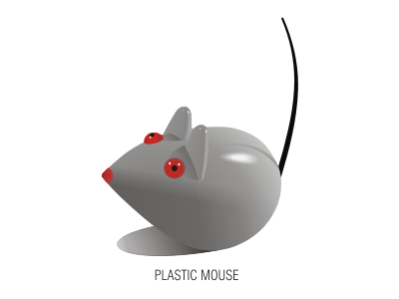
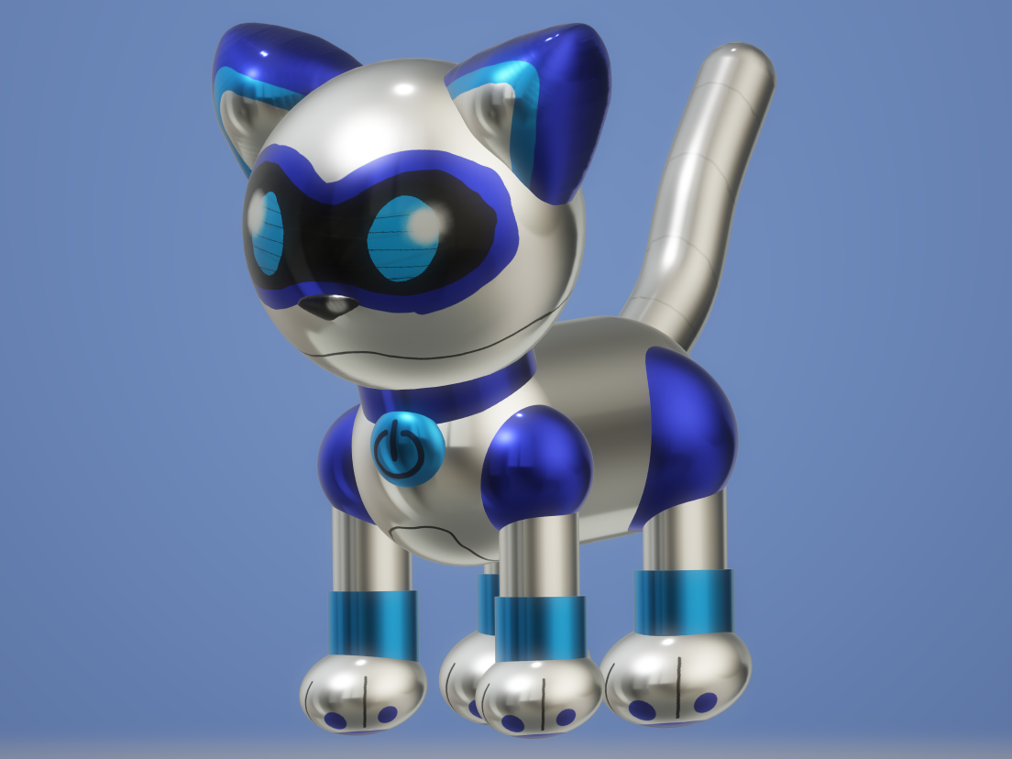
Action
U, D, L, R (one step)
State
Current loc = (D2)
Prev loc = (D1)
1 2 3 4 5
A
B
C
D
E
Notes:
Say we have a robot cat that needs to find the toy mouse. It knows it can move one step at a time either up, down, left or right.

Slide 10
Action
U, D, L, R (one step)
State
Current loc = (D2)
Prev loc = (D1)
1 2 3 4 5
A
B
C
D
E
Notes:
If we let the robot cat agent explore the environment, it will eventually get to the mouse and get a reward. So it knows that this set of actions will lead to it’s goal.
It’s not a very efficient path. However, to the cat agent, it knows that this policy leads to a reward. So why bother getting more efficient?
Here you can encourage it by adding an additional reward such as search time. A lower search time leads to a larger reward.
It might take many different attempts for it to find the quickest path. There are many advanced ways to improve convergence to the optimal path faster than brute force.
Examples of Reinforcement Learning:
Robotic Arm: https://youtu.be/ZVIxt2rt1_4?si=MvjN-syiW7ffxEEK
Mario: https://youtu.be/qv6UVOQ0F44?si=MVo4jp0J6GUNZ5cZ
Walking Simulation: https://youtu.be/gn4nRCC9TwQ?si=TY8FpTcRiGWLlNri

Slide 11




$$X_{ball}$$
Policy
$$Y_{ball}$$
Action
(up/down)
$$Y_{Opponent}$$
$$Y_{Self}$$
Notes:
Let’s go over an example to further show where the machine learning happens. Here we have the pong video game. The reward is to get a point by hitting the ball past your opponent.
The policy will take 4 inputs – the X,Y position of the ball, the position of the opponent’s paddle, and the current position of the agent’s own paddle.
- Good explanation: https://youtu.be/vXtfdGphr3c?si=z1umPaUd6wc92KX-

Slide 12
$$X_{ball}$$
Policy
w₁
$$Y_{ball}$$
Action
(up/down)
w₂
$$Y_{Opponent}$$
w₃
$$Y_{Self}$$
w₄
Notes:
Now if the policy is learned through a neural network, then you can assign weights to each of the 4 inputs and learn a policy on how to move the paddle given a specific state.
Over time, the algorithm will learn a set of weights so that it can take the right action given the current ball and paddle positions.
- Good explanation: https://youtu.be/vXtfdGphr3c?si=z1umPaUd6wc92KX-

Slide 13

Robotic Arm RL Example
Notes:
In this example, the robot needs to explore his environment and also learn how it can move its joints to get to the target point in space. So here, it’s not trying to beat an opponent. But the policy takes in its current position in space and the output is moving to the next position.
https://youtu.be/ZVIxt2rt1_4?si=UwTEk9k6courZ2N3

Slide 14
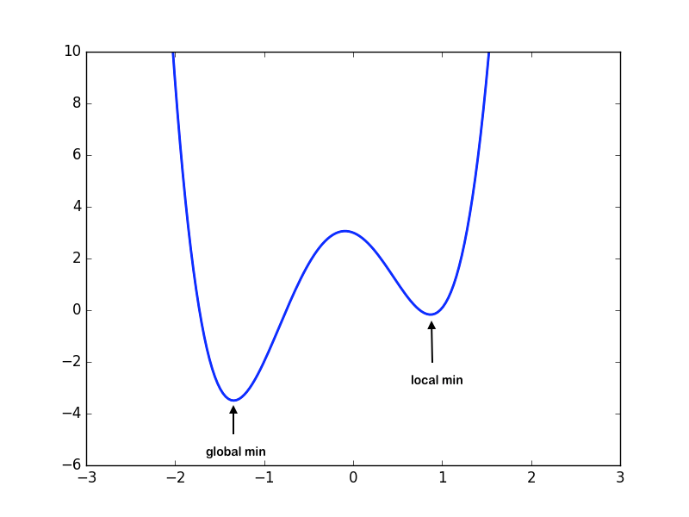
Local Minima
Starting weights
Notes:
One problem with reinforcement learning is that because you have the whole environment to play in, you can often fall into a local minima when using gradient descent.
To overcome this, you can seed your initial weights with different values so that gradient descent will take you hopefully through all the minima over time and you’ll be able to find the global minima.

Slide 15
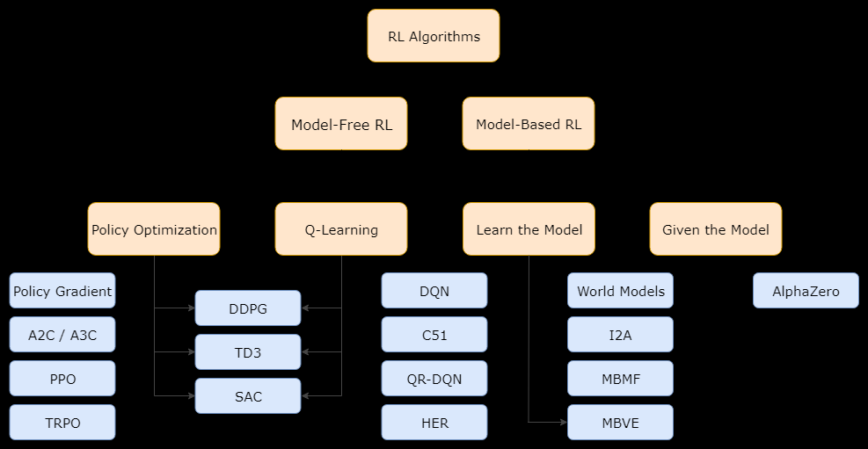
Types of RL Algorithms
Notes:
Lastly, let’s go over briefly the types of algorithms out there for Reinforcement Learning. This graphic is from OpenAI and does a pretty good job in categorizing the methods. It also agrees with the book Reinforcement Learning by Phil Winder.
At the high level, there are 2 main types. Model-Based RL is for when the actor is given or learns a model of the environment. For example, this could be for games such as chess, pong, Go. The dimensions of the game are known, there are a set number of moves that can happen at each turn and the rules are fixed. Because there are a set range of possibilities, these types of algorithms are usually able to plan several steps ahead, such as Chess and Alpha Go.
As seen in the 3rd level, the Model Based RL can further be divided based on whether the actor is given a fully defined model, or if it needs to learn the model. Learning the model would eventually give the actor perfect knowledge of the environment after exploration.
There are also model-free algorithms where the agent is not aware of the complete environment. This is like the example of the robotic arm. It needed to find the location of the dot but needed to explore it’s environment to learn where it had freedom of motion. Model-Free algorithms often work more in the real world when the environment model is not fully known.

Slide 16
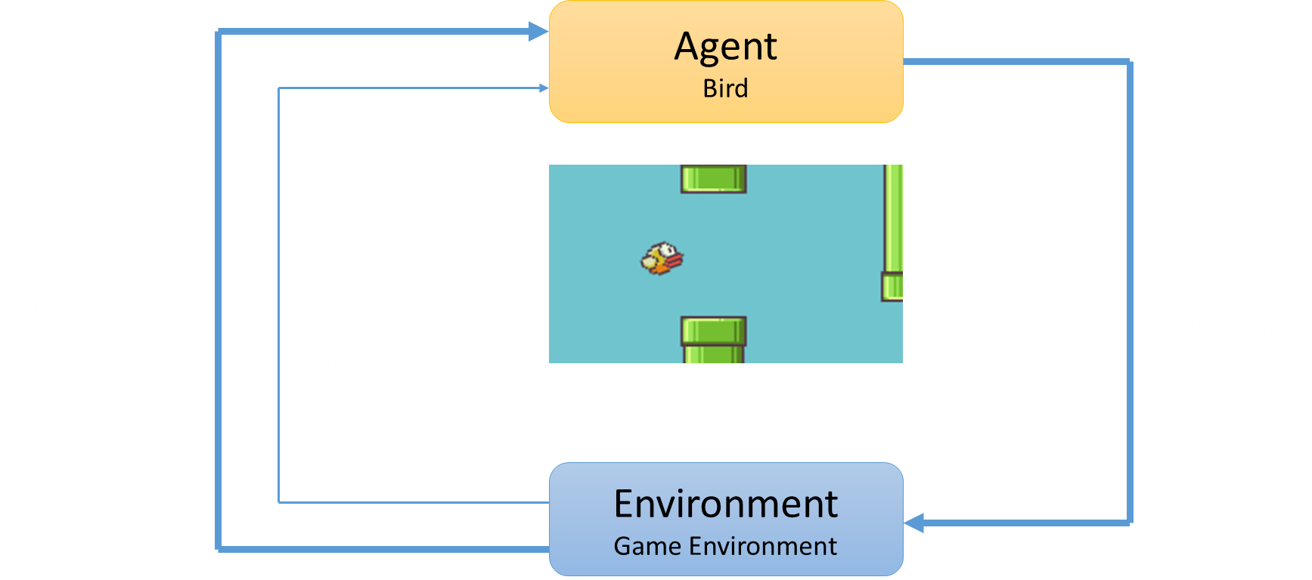
Summary
Unsupervised Learning, Supervised Learning, Reinforcement Learning
Notes:
So in summary, Reinforcement Learning is a fundamentally different type of learning that adds to your toolbox, and complements unsupervised and supervised learning.
The Agent is the entity doing the action, they operate in the environment, they follow a set of rules. They assess their current state as input and make a prediction of what future action will get them a reward. And this prediction is called a policy.
For this module, we will not be doing a python lab, but it may be offered at a future date.

